Slide 1
Interconnection of components

Slide 2
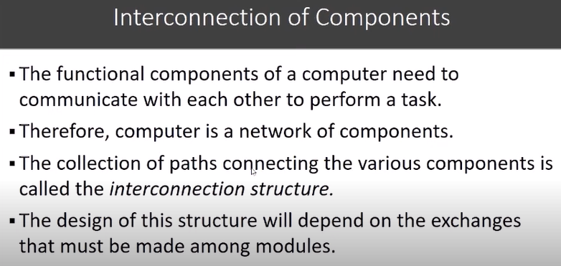

Slide 3
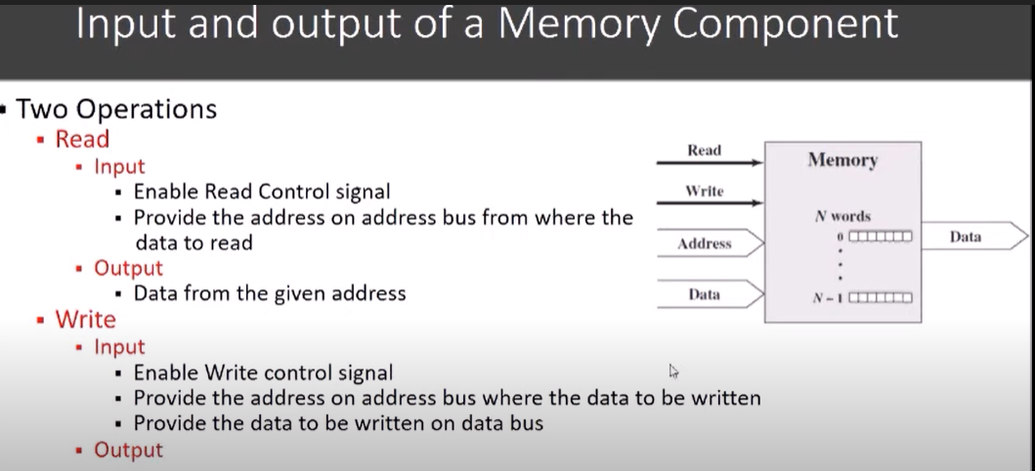


Slide 4
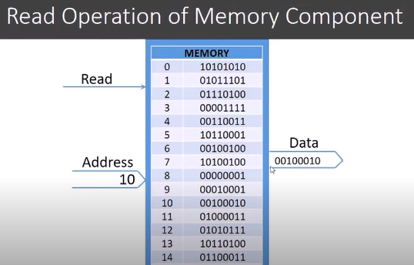

Slide 5
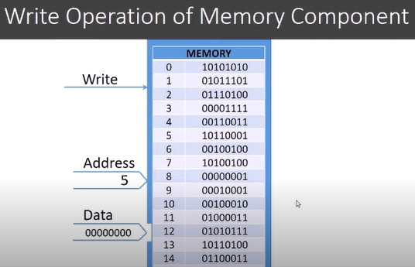

Slide 6
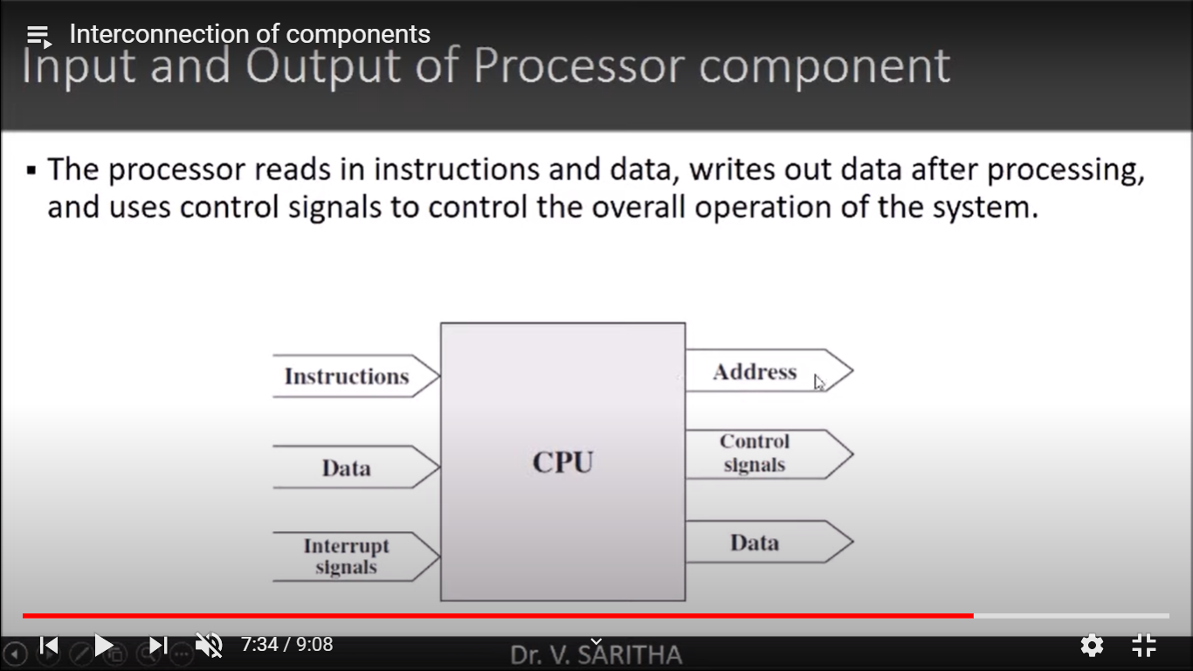

Slide 7
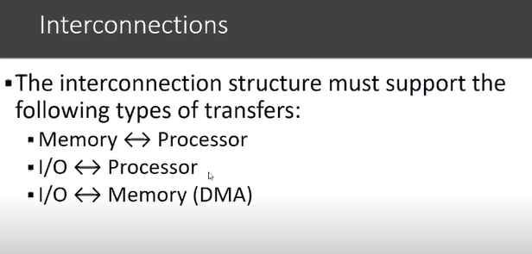
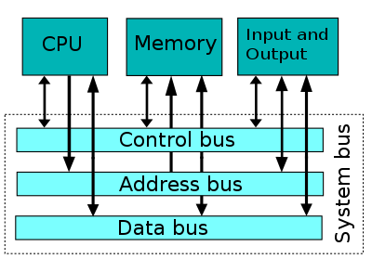

Slide 8
Register and Register Files

Slide 9
What are Registers?
A register is a small amount of storage available on the CPU whose contents can be accessed more quickly than storage available elsewhere (such as main memory)
They are the fastest way for the CPU to access data, since the CPU doesn’t have to utilize the address bus to get data from main memory
Standard computers today come with processors that use the x86 architecture, using 32-bit registers for data and only a few register files

Slide 10
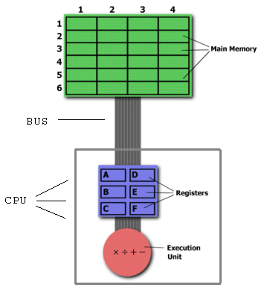
Layout of CPU and Memory

Slide 11
Registers
Memory Hierarchy
  Registers
  Cache memory
  Main memory
  Secondary memory
At higher levels of hierarchy, memory is faster, smaller and more expensive.
Number and function vary between processor designs - one of the major design decisions
Top level of memory hierarchy
Two roles
  User-visible registers
  Control and status registers

Slide 12
User-Visible Registers
General Purpose
Data
Address
Condition Codes

Slide 13
General Purpose Registers
True general purpose registers – register can contain the operand for any Opcode
Restricted – used for specific operations – floating point and stack operations. (dedicated registers)
Data registers – used only to hold data and cannot be employed in the calculation of an operand address – Accumulator (AC)
Address registers
An address register is a type of processor register that stores the address or location of data or instructions within a computer’s main memory.

Slide 14
Condition Code Registers – Flags
Condition codes are bits set by the CPU hardware as the result of operations.
Sets of individual bits, flags
  e.g. result of last operation was zero
Can be read by programs
  e.g. Jump if zero – simplifies branch taking

Slide 15
Commonly used Registers
Accumulator: This is the most common register, used to store data taken out from the memory.
General Purpose Registers: This is used to store data intermediate results during program execution. It can be accessed via assembly programming.
Data Register : These registers only holds the data. The restriction of these registers is, these can not be used for operand address calculation

Slide 16
Special Purpose Registers:
Users do not access these registers. These registers are for Computer system,
  MAR: Memory Address Register are those registers that holds the address for memory unit.
  MBR: Memory Buffer Register stores instruction and data received from the memory and sent from the memory.
  PC: Program Counter holds the address of the next instruction to be read from memory after the current instruction is executed.
  IR: Instruction Register holds the instruction to be executed.

Slide 17
Control / Status registers
Parity Flag (PF) − It indicates the total number of 1-bits in the result obtained from an arithmetic operation.
Sign Flag (SF) − It shows the sign of the result of an arithmetic operation. This flag is set according to the sign of a data item following the arithmetic operation.
Zero Flag (ZF) − It indicates the result of an arithmetic or comparison operation. A nonzero result clears the zero flag to 0, and a zero result sets it to 1.
Auxiliary Carry Flag (AF) − It contains the carry from bit 3 to bit 4 following an arithmetic operation;
Carry Flag (CF) − It contains the carry of 0 or 1 from a high-order bit (leftmost) after an arithmetic operation. It also stores the contents of last bit of a shift or rotate operation.

Slide 18
Control /Status registers
Program status word (PSW): This register contains status information. This also contains condition codes as well as some status information.
Overflow Flag (OF) − It indicates the overflow of a high-order bit (leftmost bit) of data after a signed arithmetic operation.
Direction Flag (DF) − It determines left or right direction for moving or comparing string data.
Interrupt Flag (IF) − It determines whether the external interrupts like keyboard entry, etc., are to be ignored or processed.

Slide 19

Example Register Organizations

Slide 20
Processor Registers – Intel Architecture
There are ten 32-bit and six 16-bit processor registers in IA-32 architecture. The registers are grouped into three categories −
  General registers,
  Control registers,
  Segment registers.
The general registers are further divided into the following groups −
  Data registers,
  Pointer registers,
  Index registers.

Slide 21
Data Registers
Some of these data registers have specific use in arithmetical operations.
AX is the primary accumulator; it is used in input/output and most arithmetic instructions. For example, in multiplication operation, one operand is stored in EAX or AX or AL register according to the size of the operand.
BX is known as the base register, as it could be used in indexed addressing.
CX is known as the count register, as the ECX, CX registers store the loop count in iterative operations.
DX is known as the data register. It is also used in input/output operations. It is also used with AX register along with DX for multiply and divide operations involving large values.

Slide 22
Pointer Registers
The pointer registers are 32-bit EIP, ESP, and EBP registers and corresponding 16-bit right portions IP, SP, and BP. There are three categories of pointer registers −
Instruction Pointer (IP) − The 16-bit IP register stores the offset address of the next instruction to be executed.
Stack Pointer (SP) − The 16-bit SP register provides the offset value within the program stack.
Base Pointer (BP) − The 16-bit BP register mainly helps in referencing the parameter variables passed to a subroutine.

Slide 23
Index Registers
The 32-bit index registers, ESI and EDI, and their 16-bit rightmost portions.
SI and DI, are used for indexed addressing and sometimes used in addition and subtraction.
There are two sets of index pointers −
  Source Index (SI) − It is used as source index for string operations.
  Destination Index (DI) − It is used as destination index for string operations.

Slide 24
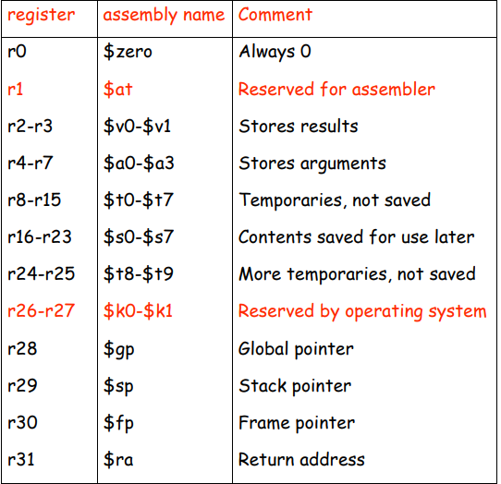
MIPS Registers

Slide 25
Register Files (RF)
Set of general purpose registers.
It functions as small RAM and implemented using fast RAM technology.
RF needs several access ports for simultaneously reading from or writing to several different registers. Hence RF is realized as multiport RAM.
A standard RAM has just one access port with an associated address bus and data bus.

Slide 26
A register file with three access ports - symbol
Data in C
16
2
Address C
Port C
Register File
RF
2
2
Address A
Port A
Port B
Address B
16
16
Data out A
Data out B

Slide 27
A Register File with three access ports – logic diagram
Ex: R3 ← R1 + R2
Read Address A = 01
Read Address B = 10
Write Address C = 11
Data in C
16
11
2
Write
address C
4-way 16-bit
demultiplexer
S
16
16
16
16
16-bit register R3
16-bit register R2
16-bit register R1
16-bit register R0
0101
16
16
●
16
●
●
16
●
2
4-way 16-bit
multiplexer
4-way 16-bit
multiplexer
2
01
S
S
Read
address A
Read
address B
16
16
Data out A
Data out B

Slide 28
A Register File with three access ports – logic diagram
1011
Ex: R3 ← R1 + R2
Read Address A = 01
Read Address B = 10
Write Address C = 11
Data in C
16
11
2
4-way 16-bit
demultiplexer
Write
address C
S
16
16
16
16
16-bit register R3
16-bit register R2
16-bit register R1
16-bit register R0
0110
0101
16
16
●
16
●
●
16
●
2
4-way 16-bit
multiplexer
4-way 16-bit
multiplexer
2
01
S
S
10
Read
address A
Read
address B
16
16
Data out A
Data out B

